Slide 1


Computer Applications to Behavioral Sciences
Lecture 21. Graph with Matplotlib
https://psychology-courses.appspot.com/
Dr. Jibo He
Wichita State University
hejibo@gmail.com

Slide 2
Introduction
“make easy things easy and hard things possible“
create simple plots with just a few commands
“emulate” MATLABs plotting capabilities
matplotlib is conceptually divided into three parts
Pylab interface : MATLAB like plotting
Matplotlib API : abstract interface
Backends : managing the output
available at (including many examples)
http://matplotlib.sourceforge.net/

Slide 3
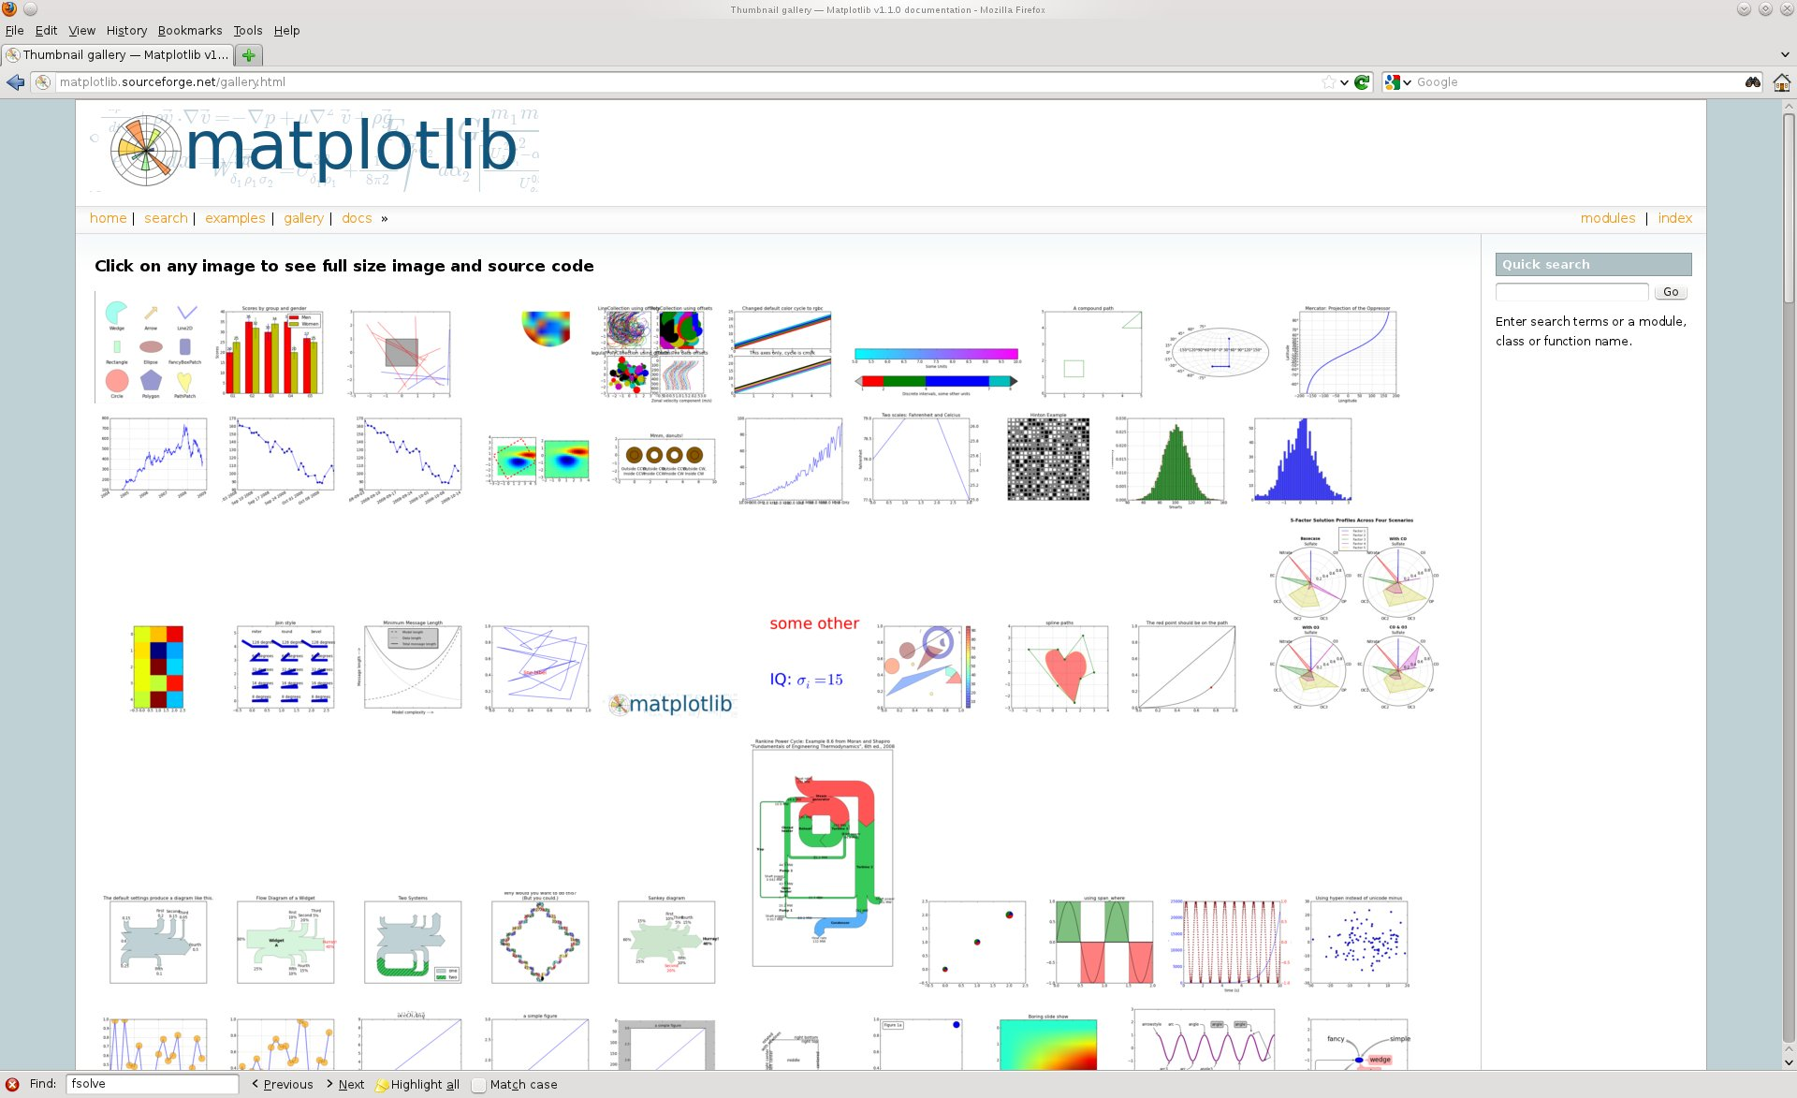
The Gallery
http://matplotlib.sourceforge.net/gallery.html

Slide 4
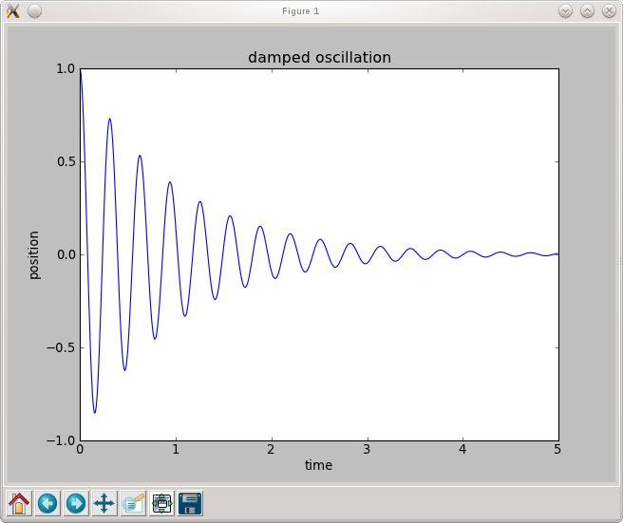
Basic 2D - plotting
line plot represents data
title and labels
toolbar for zooming, saving/exporting etc.
appearance depend on backend

Slide 5
Basic 2D - plotting
Matlab like example:
import numpy as np # import numpy
import pylab as pl # import pylab interface
times = np.arange ( 0, 5, 0.01 ) # define x-vector
fun = lambda x : np.cos (20 *x) * np.exp (- pl.absolute(x) )
# define some function fun (x)
pl.plot ( times, fun(times) ) # plot fun (t) vs. t
pl.xlabel ('time' ) # creating x-label
pl.ylabel ('position') # creating y-label
pl.title ( 'damped oscillation') # setting the title
pl.show() # show the plot

Slide 6
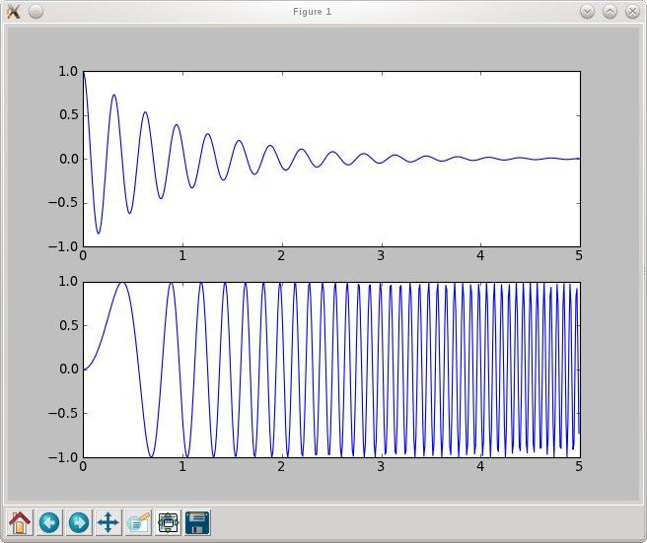
Subplots
subplot (2,1,1) :
2 columns, 1 row
choose first subplot
! Indexing starts with 1
subplot (2,1,2) :
2 columns, 1 row
choose second subplot

Slide 7
Subplots
import numpy as np # import numpy
import pylab as pl # import pylab interface
times = np.arange ( 0, 5, 0.01 ) # define x-vector
fun = lambda x : np.cos (20 *x) * np.exp (- pl.absolute(x) )
fun2 = lambda x : np.sin (10 *x**2) # define two functions
pl.subplot (2,1,1) # choose a subplot ( rows, colums, idx)
pl.plot ( times, fun(times) ) # plot fun(t)
pl.subplot (2,1,2) # choose a subplot ( rows, colums, idx)
pl.plot ( times, fun2(times) ) # plot fun2(t)
pl.show()

Slide 8
Subplots Exercise
How to make the figures side by side?

Slide 9
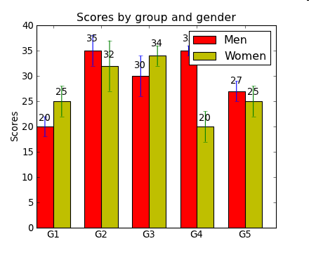
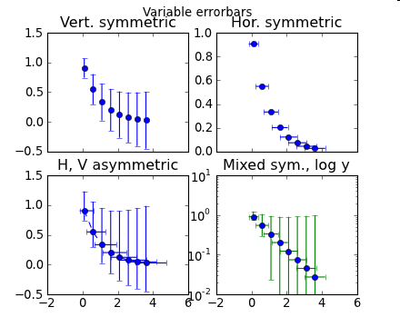
Other basic plotting commands
pl.bar () # box plot
pl.errorbar() # plot with errorbars
pl.loglog() # logarithmically scaled axis
pl.semilogx () # x-axis logarithmically scaled
pl.semilogy () # y-axis logarithmically scaled

Slide 10
Histograms
import numpy as np # import numpy
import pylab as pl # import pylab interface
data = 3. + 3. * np.random.randn (100000)
# generate normally distributed randonnumbers
pl.subplot (2,1,1)
pl.hist (data, 100) # make histogram with 100 bins
pl.subplot (2,1,2)
pl.hist ( data, bins = np.arange(3, 25, 0.1) )
# make histogram with given bins
pl.axis ( (3, 15,0,2000 )) # specify axis (x1,x2,y1,y2)
pl.show()

Slide 11
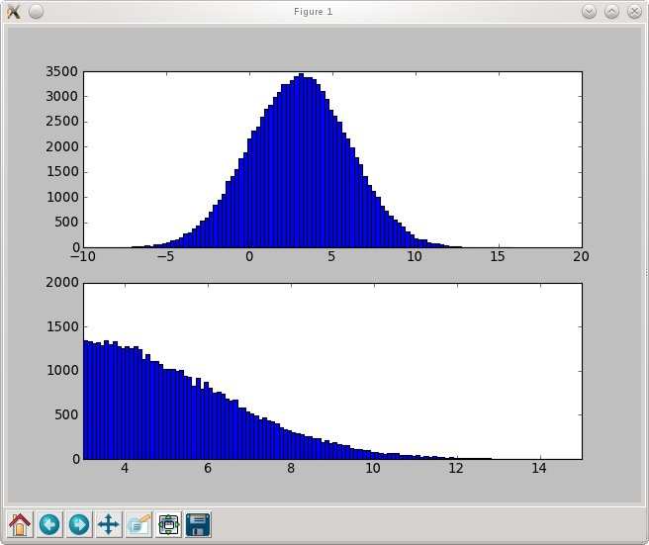
Histograms
(automatic) histogram with 100 bins
histogram for data between 3. and 25. with binsize 0.1
axis set to (3,15,0,2000)

Slide 12
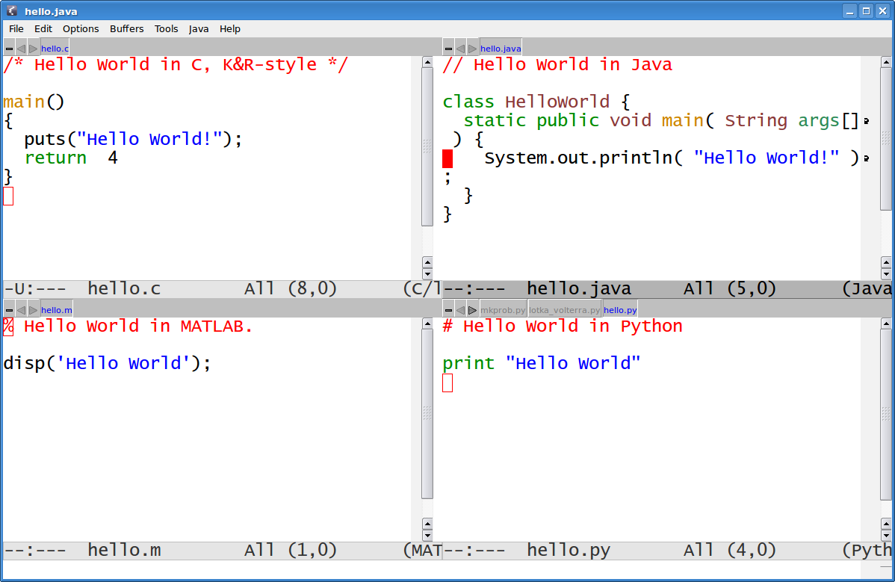
C, JAVA, MATLAB, vs. Python

Slide 13




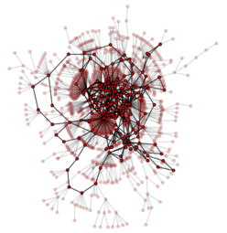





Slide 14
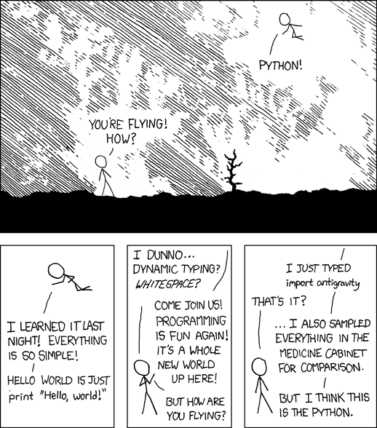

Slide 15
Thank You

